Slide 1
Analyzing Seattle terry stops

Slide 2
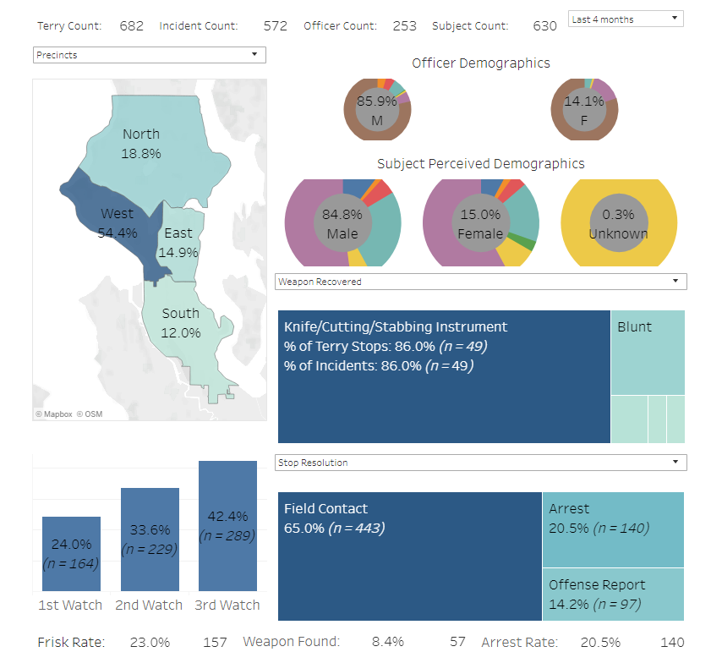
Start by cleaning the dataset
Imagine provided by the seattle.gov terry stops dashboard.

Slide 3
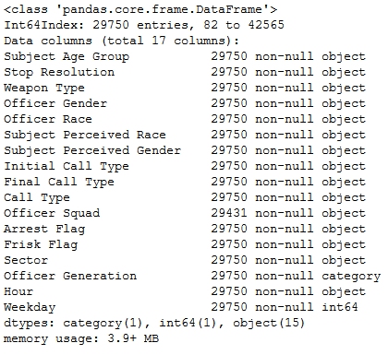
The new dataset:
-Duplicates removed
-year of officer birth binned into decades
-arrest time binned into hours
-arrest date binned into days of week
-missing data removed
-rare events grouped together
-Subject ID, Go Num, Terry stop ID, Precinct and Beat removed
-all data one hot encoded into categories

Slide 4
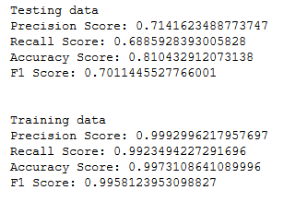
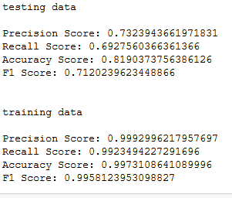
Choosing an algorithm
First attempt was K Nearest Neighbor, which failed due to the size of the dataset
Next was a basic Decision tree. Note that a visualization is difficult due to the hundreds of columns present.
Both entropy and gini criteria were used
All of the training metrics were 99+, while the testing data was not.
Clear case of overfitting, the model needs to be redone

Slide 5
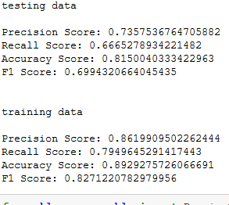
Best Decision Tree
A grid search finds that the best factors are: criterion=gini, max_depth=none, min_samples_leaf=6,min_samples_split=2
Much better metrics! Now we check if we can’t improve them

Slide 6
Which metric to use to score
Accuracy was chosen as the preferred scoring tool rather than precision or recall. Precision is typically used to minimize false positives, recall is used to minimize false negatives. Since there is no particular reason to prefer one over the other, accuracy scoring was selected.

Slide 7
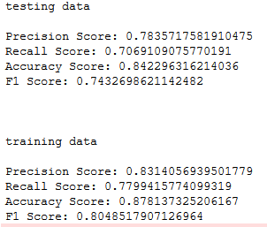
Playing with Decision Trees
Several different types of decision trees were used, included bagged trees, random forests, and extreme gradient boosted trees. The best was an XGB Classifier the parameters:
'learning_rate': 0.2, 'max_depth': 6, 'min_child_weight': 1, 'n_estimators': 100, 'subsample': 0.7

Slide 8
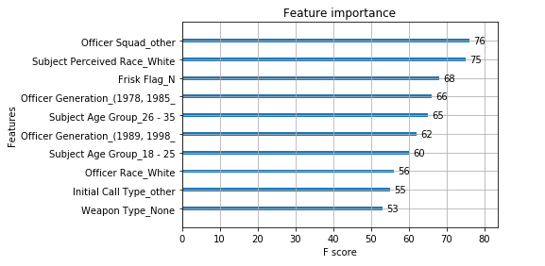
Feature importance
What were the top 10 features determining if a person was arrested during the terry stop?

Slide 9
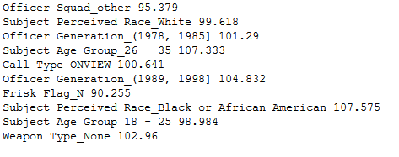
Correlation or anti-correlation?
A feature appearing in the top 10 only means that it is a strong predictor, but it doesn’t say if it correlates with ‘arrest’ or ‘no arrest’. The average arrest rate is ~32%, each feature was subgrouped and the arrest rate was calculated as a proportion of the total.

Slide 10
Anti-correlations
-Officer Squad_other has a low score, implying that officers from squads that rarely conduct Terry Stops were also less likely to make an arrest during a stop.
-Frisk Flag_N also has a low score, meaning that if an officer does not suspect a weapon, the subject is more likely to be freed. Frisk Flag_Y does not appear in the top 10, presumably because it would split into “weapon found” and “weapon not found”.
-Young subjects, aged 18-25, were slightly less likely to be arrested.
-White people are slightly less likely to be arrested, on average

Slide 11
Direct Correlations
-Subjects aged 26-35 were SIGNIFICANTLY more likely to be arrested
-Officers born between 1989 and 1998 were very likely to make arrests. Officers born 78-85 were only slightly more likely to make arrests.
-Black people had the highest positive correlation of all the features. This supports the common knowledge that African Americans are vastly over-policed.
-Police are more likely to make an arrest if they initiate the stop by witnessing suspicious activity (as opposed to responding to 911).
-Surprisingly, not finding a weapon makes it MORE likely to arrest a suspect.

Slide 12
Confounding variables
It should be noted that further investigation would be needed to support the hypotheses presented as to why the features correlate/anti-correlate with arrest rate. In particular, one can divide each aggregate into subcomponents based on their interactions with other features, and one would likely find confounding factors: one subgroup could have a positive correlation, and another negative. This is likely why the features with higher F-scores don’t necessarily have higher deviations from average arrest rate.

Slide 13
Final analysis
Black people were 8% more likely to be arrested during a stop.
The XGB classifier was tested on data where all individuals had their races flipped: black people were replaced with white people and vice versa, while all other factors were kept the same.
Black-turned-white people were arrested 4.5% less often
White-turned-black people were arrested 7.7% less often
BtW people were arrested at the same rate as the original group of white people, which makes total sense. However, WtB people had their arrest rate drop as well! This is a very bizarre finding. No interpretation of this result that conforms with common understanding of police-race relations comes to mind

Slide 14

Gender
Finally, gender was surprisingly not included in the top 10 features. However, that is not to say that the gender disparity is not significant: as one can see in the original dataset, black women are more likely to be arrested than the average man.

